Slide 1


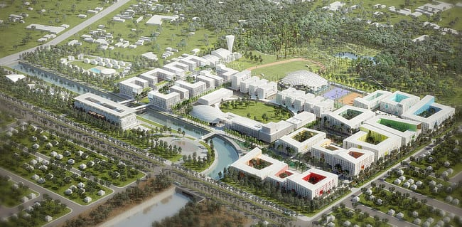
Build your smart campus
EXECUTIVES:-
ABHAY
&
VIKRAM

Slide 2
What is your task:-
You have to build your smart campus in a
Rectangular block of dimension 1000m*800m area.
In which following parts must be included:
Buildings
Roads and gates
Sports area
Greenery

Slide 3
Campus component and structures in a plan : -
STRUCTURE | COMPONENTS | NOTATION | CAPACITY | COMPONENT REQUIREMENT | COMPULSORY MENTIONING
1.DEPARTMENTS | Civil, Mechanical, Electrical, Computer Science, Chemical, Electronics and communication, Common lecture hall (*For first year only), Administration. | CE-CIVIL ME-MECHANICAL CHE-CHEMICAL ECE-ELECTRONICS & COMMUNICATION CSE-COMPUTER SCIENCE EE-ELECTRICAL CLH- COMMON LECTURE HALL, A-ADMINISTRATION. NOTE – IN EVERY DEPARTMENT YOU HAVE TO ADD ONE LABORATORY BUILDING | DEPARTMENT -400 student +30 teacher COMMON LECTURE HALL – 2000 STUDENT LABORATERIES – 200 STUDENT + 10 TEACHER | DEPARTMENT-CLASSROOM, TEACHER CABIN, WASHROOMS, AND PASSAGE AREA COMMON LECTURE HALL – CLASSROOM, WASHROOMS AND PASSAGE AREA | DEPARTMENT- CLASSROOM, TEACHER CABIN, AND TOTAL AREA LABORATORIES – EACH STUDENT NEED 1 metre square. COMMON LECTURE HALL – CLASSROOM, TEACHER CABIN AND TOTAL AREA

Slide 4
2.HOSTELS | You have to mention how many hostels you need for students of Btech, Mtech, PHD | H-number of hostels Example: hostel second will be name as H-2. NOTE: (you have mention which year student will live there separately not in diagram as H-2-for first year ). | HOSTEL CAPACITY – : EACH YEAR HAVE 8:2 BOYS AND GIRLS RATIO. *EACH HOSTEL HAVE MINIMUM 800 STUDENTS | HOSTEL – MESS, 2 SEATED ROOM OR 1 SEATED ROOM, BATHROOM, PASSAGE AREA, LIBRARY, NIGHT CANTEEN, ENTERTAINEMENT ROOM, ENQUIRY ROOM | HOSTEL – MESS, 2 SEATED ROOM OR 1 SEATED ROOM AND TOTAL AREA
3.SPORTS ACTIVITY AREA | Minimum 6 sports area you have provide of your choice | You have to assign notation of your own but at last you to write their abbreviation. |  |  | Total area allotted for each sport you have added
4.FACULTY HOUSE AND GUEST HOUSE | Different blocks for director house / faculty house/ Guest house | FH-number of that building This is for faculty house GH- for guest house | FACULTY HOUSE – 200 TEACHERS GUEST HOUSE- 50 ROOM | FACULTY HOUSE – 2 BHK (2 BEDROOM, HALL, KITCHEN) +BATHROOM +BALCONY. *GH-YOU HAVE TO MENTION PLOT AREA | Total area of faculty house and guest house

Slide 5
5. FACILITY | Library, seminar hall, celebration ground etc. Here you to add at least 4 | Example: L-library SH-seminar hall etc (At last you have add your abbreviation you are using) |  | YOU HAVE TO MENTION THE PLOT AREA. | ALL BUILDING APPROX AREA YOU HAVE TO MENTION ON PLAN
6.EXTRA ACTIVITY | LIKE canteen, lawn/garden, medical, bank, Shops etc Here you have to add at least 5 | As per your own convenience but you have mention at last the abbreviation too. |  | YOU HAVE TO MENTION THE PLOT AREA | ALL BUILDING APPROX AREA YOU HAVE TO MENTION ON PLAN
7.ROAD network ,PARKING AREA AND GATES | You have to mention the distance of road | G-gates | | - roads P-parking area |  | DISTANCE OF EACH AND EVERY ROAD DRAWN
8.WATER SUPPLY STATION | A water container | WS- water supply | 8000 LITRES | BUILDING BLOCK
*NOTE- YOU HAVE TO USE AT LEAST 30% OF AREA OF WHOLE CAMPUS IN BUILDINGS

Slide 6
How you will explain what innovative you have done: -
You have to build your smart campus on the basis of following criteria :
Accessibility to sources
Green campus
Security
Transportation
Economical
*NOTE- WHILE MAKING BUILDING YOU HAVE TO CONSIDER ALL ABOVE POINT

Slide 7
Rules :-
You have to draw a plan on a white A-4 sheet or white graph paper .
The time allotted will be of 1 hour and 15 minutes.
You have to work in group of two.
You have to draw with pencil only and written work can be done by pen also you ca use calculator.
You have to click a photo through any scanner available in play store and then you have to make a pdf in (.pdf) format.
After that a google form will be provided to you in google meet chat box where you have to submit.

Slide 8
Judgement criteria :-
The judgement will on basis of following:
Accessibility (how easily all department, hostel, basic facility are connects in terms of distance of roads you will mention) - 30 POINTS
Proper following of all criteria(notations, plan of campus and criteria of smart campus) – 20 POINTS
How much your calculated /assumed area value are practically possible– 50 POINTS

Slide 9
*NOTE- EXAMPLE :- HOW YOU WILL WRITE THE ANSWER YOU HAVE CALCULATED
FOR DEPARTMENT-:
CE-CIVIL
CAPACITY- 430(EXAMPLE)
TOTAL AREA- ?
NO. OF CLASSROOMS-?
CLASSROOM AREA-? AND EACH CLASSROOM CAPACITY-?
TEACHER CABIN AREA-?
No of floor -?

Slide 10
FOR HOSTEL :-
H-1
CAPACITY-1200(EXAMPLE)
NO. OF ROOMS/THEIR AREA :- DOUBLE-x (? m^2)
SINGLE-y (? m^2)
MESS AREA :-?
TOTAL AREA:-?
FOR CLH :-
TOTAL CAPACITY-2000
TOTAL AREA-?
NO. OF CLASSROOMS-?
CLASSROOM AREA-? AND EACH CLASSROOMS CAPACITY-?

Slide 11


Slide 12


